Slide 1
Fort Hunter Liggett iSportsman Beginner’s Guide
November 2025

Slide 2
This guide will help you through the process of:
Creating your iSportsman Account ………………..3
Safety Briefs …………………………………………4
Vetting ………………………………………………..5
Firearms Registration ………………...………….....6
California Hunting/Fishing License ………………..7
Discounted Annual Hunting Permit ………………..8
Purchasing your Permit ………………………….9-11
What Areas are Open? ………………………...12-13
Making Reservations and Checking in/out …..14-17
Adding Guests……………………………………....18
Check Station……………………………………19-20
Going Afield …………………………………………21

Slide 3
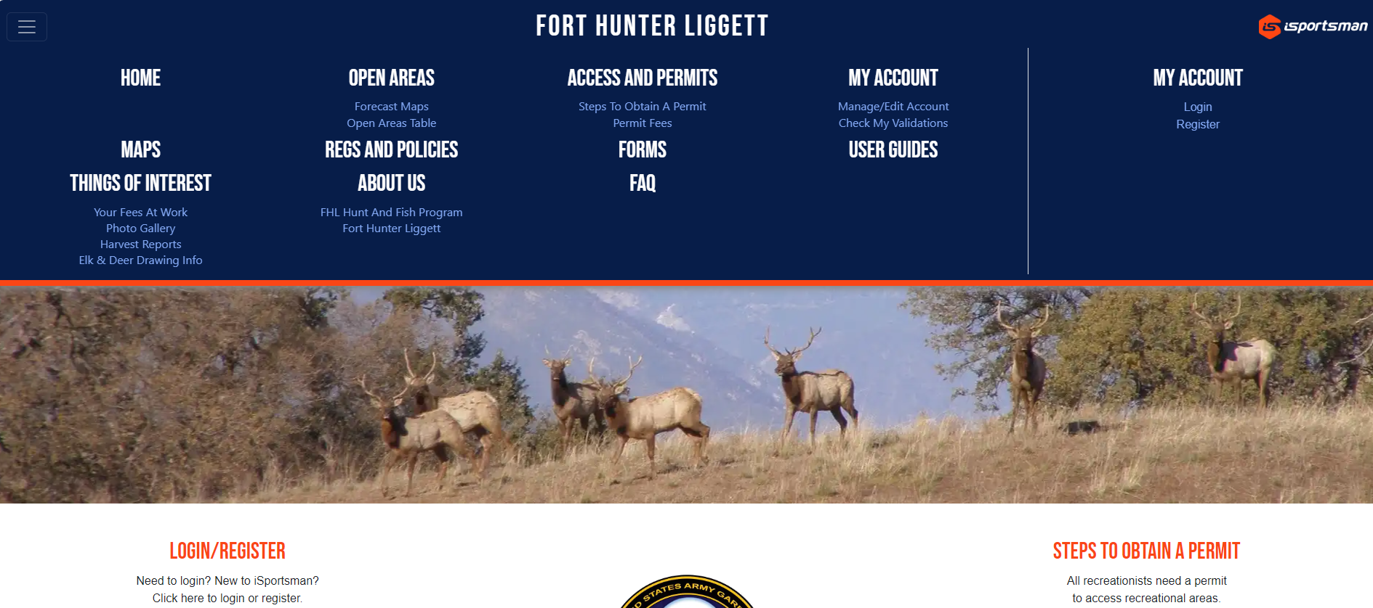
STEP 1. Creating your iSportsman Account
Previous Account Holders: If you created an iSportsman account previously at FHL or another installation do not create a new account. Use that account.
New Users: If you do not have an iSportsman account, then register for one by clicking here: Register or going to our website (https://fthunter.isportsman.net).

Slide 4
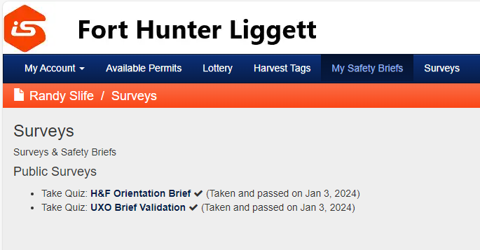
STEP 2. Safety Briefs
Everyone must watch both safety briefs (UXO and H&F Orientation) that are found under the “My Safety Briefs” tab on your iSportsman account page. Answer the questions that follow each video. Once submitted, this hold is removed, and your permits will be available for purchase.

Slide 5
STEP 3. Vetting
As of 8/7/2024, the requirement for annual vetting has been waived for Hunting and Fishing Program customers who will not enter the cantonment area.
Anyone who has been denied access is still barred from hunting or fishing or otherwise entering Fort Hunter Liggett property.
For more information on access to the cantonment area, please contact the Visitor Control Center (VCC): Website: https://home.army.mil/liggett/about/visitor-information, Phone: 831-386-3875, Email: usarmy.hunterliggett.id-readiness.mbx.des-vcc@army.mil

Slide 6
STEP 4. Firearms Registration (Only Required for Cantonment)
As of 8/7/2024, the requirement for firearm registration has been waived for hunters who will not enter the cantonment area.
To bring firearms onto the cantonment area, you must complete the FHL Personal Firearms Registration Form through the VCC.
The firearms registration is valid for 3 years from issuance.
Air guns must be registered.
Archery equipment does not need registered.
Firearms registration is not a hold on your account and does not prevent you from purchasing a FHL hunting permit.
Once your firearm is registered, the VCC will email you a copy of your FHL weapon permit.
Always keep your FHL weapon permit with you and the firearm while on the cantonment area.
If you have not received an email from the VCC after 30 days, check the status of your firearms registration by calling the VCC at (831) 386-3875.
The FHL H&F program DOES NOT HANDLE firearms registrations.
Fill out the FHL Personal Firearms Registration Form completely, sign (or type your name in the signature box), and email the completed form with a copy of an acceptable photo ID to the VCC at:
usarmy.hunterliggett.id-readiness.mbx.des-vcc@army.mil
Firearms Registration Form

Slide 7

STEP 5. California Hunting/Fishing License
Anyone who wishes to purchase a FHL hunting and/or fishing permit must obtain a valid CA hunting and/or fishing license for the same year (e.g., a 2024-25 CA hunting license for a 2024-25 FHL hunting permit).
iSportsman will prompt you for your CA Hunting License document number
(D - ########## - #) upon checkout.

Slide 8
STEP 6. Discounted Annual Hunting Permit
Disabled Veterans, Recovering Service Members, and Junior hunters are eligible for a discounted annual hunting permit.
Recovering Service Members and Disabled Veterans must send a copy of their CA hunting license to the FHL H&F program at:
usarmy.hunterliggett.id-readiness.mbx.hunt-and-fish-program@army.mil
Junior hunters do not need to send in a copy of their CA hunting license. If both safety briefs are complete and they are below the age of 16, they will be able to purchase a FHL junior hunting permit.

Slide 9
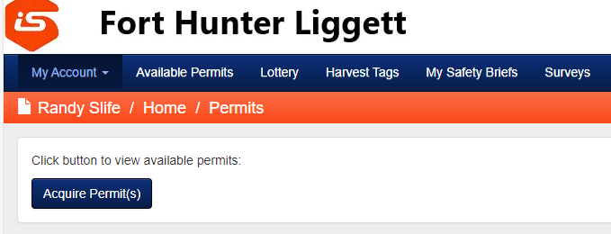
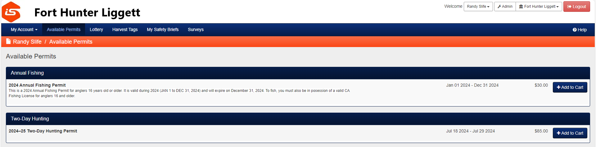
STEP 7. Purchasing your Permit
Log into iSportsman and purchase the desired permit(s).
ALL SALES ARE FINAL. Review your order carefully before purchase. The FHL H&F Program DOES NOT provide refunds.

Slide 10
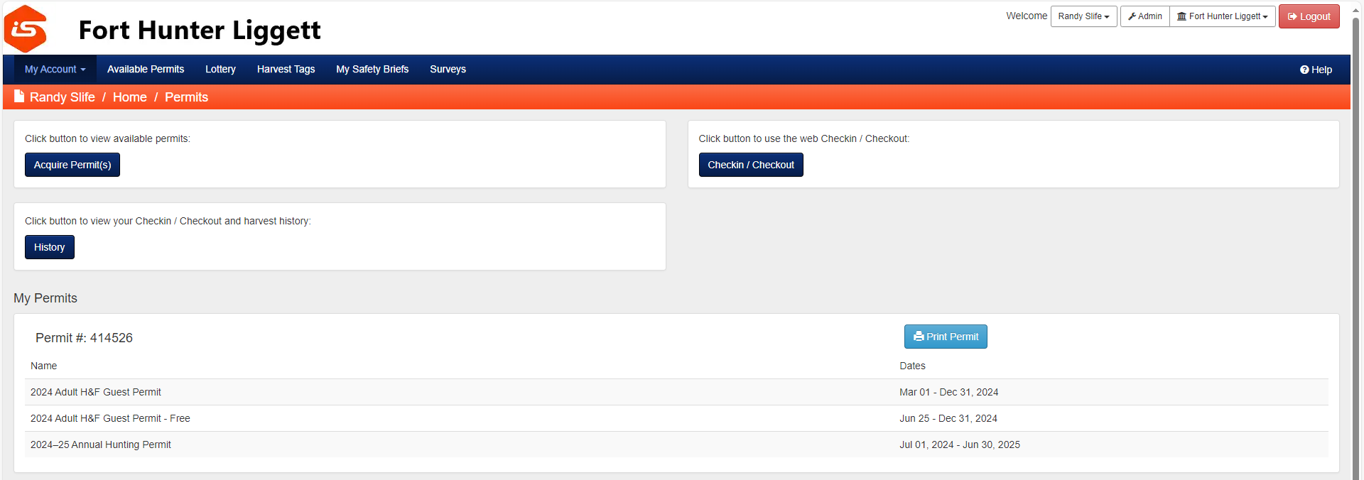
STEP 7. Printing your Permit

Slide 11
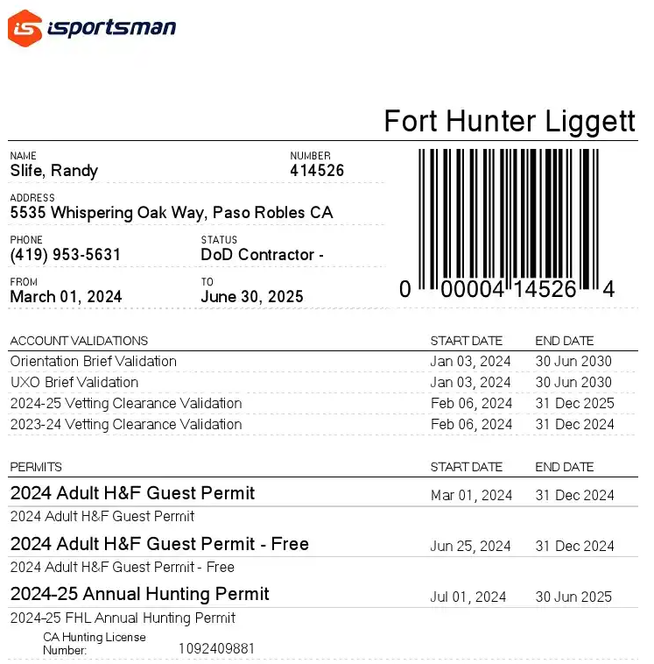
STEP 7. Printing your Permit
Last, First
123456
P.O. Box 7091 Ft. Hunter Liggett, CA 93928
(831) 386-2954
D - ########## - #

Slide 12
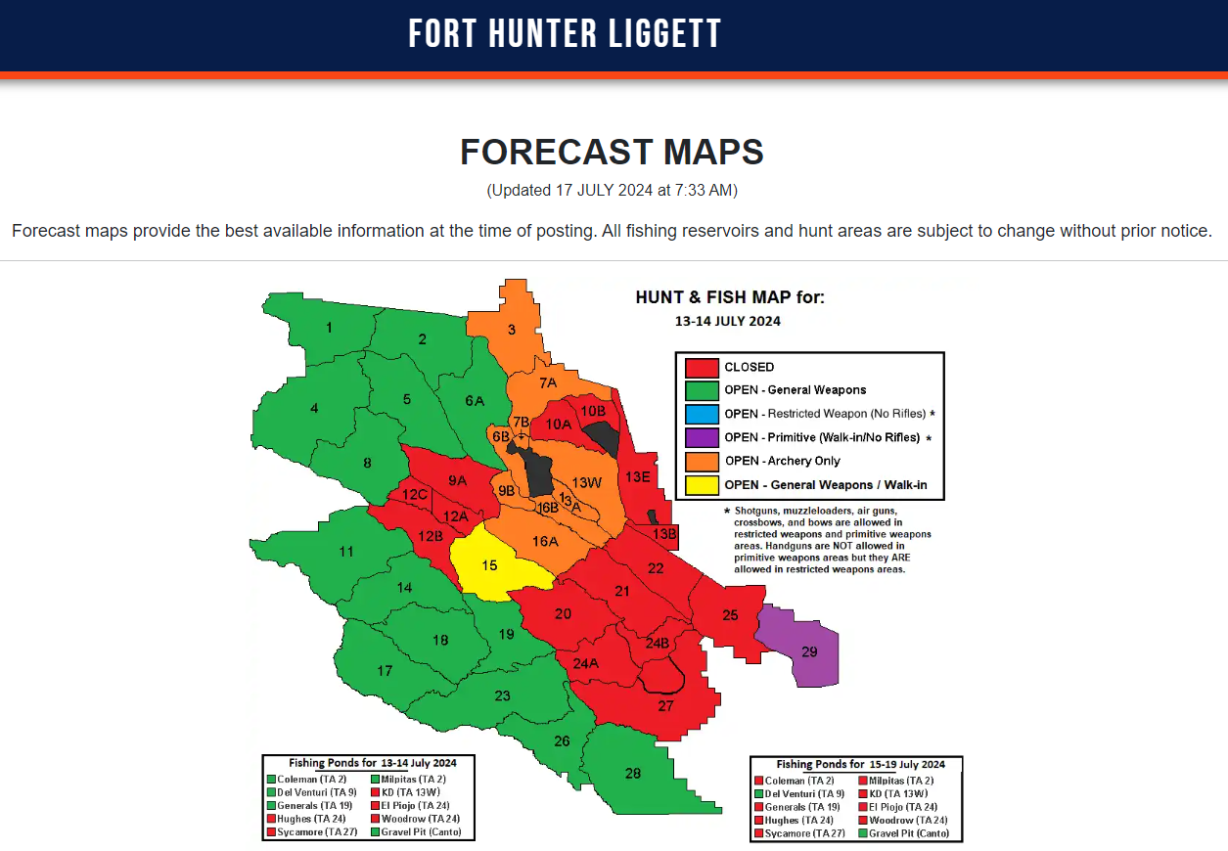
STEP 8. What Areas are Open?
Area availability can be found on the Forecast Maps tab.
Fishing is available throughout the week.
Hunting is available Saturday through Tuesday and Federal holidays. Availability is dependent on training, natural resources, and force protection requirements.
Please see Chapter 5 Section 5-1 on weekday hunting in the FHL Hunting and Fishing Regulations.

Slide 13
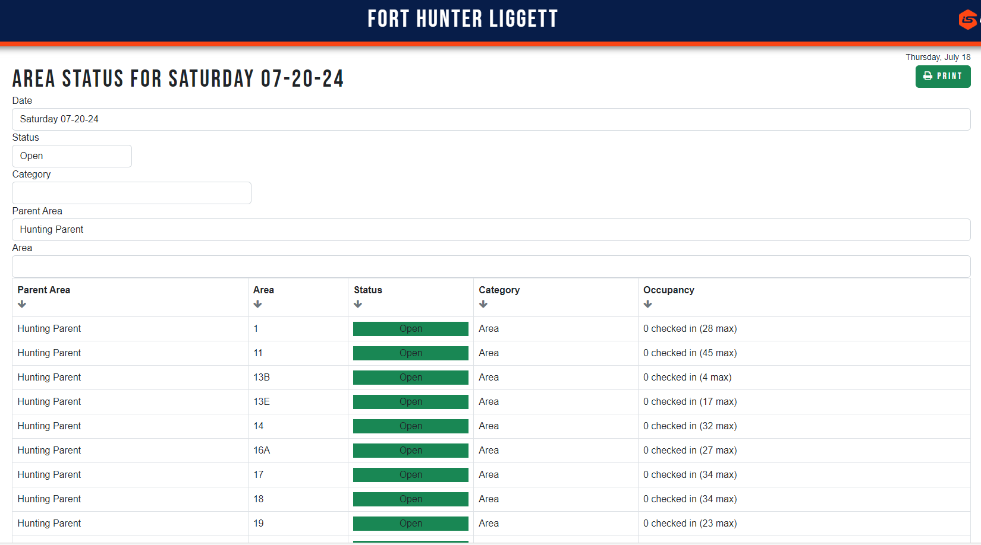
STEP 8. What Areas are Open?
If you plan on changing your hunt area and want to see what slots are available, check out the Open Areas Table. This will only show check-ins, not reservations.

Slide 14

STEP 9. Making Reservations and Checking in/out
Click the Checkin/Checkout button to begin the Reservation/Check-In process.

Slide 15
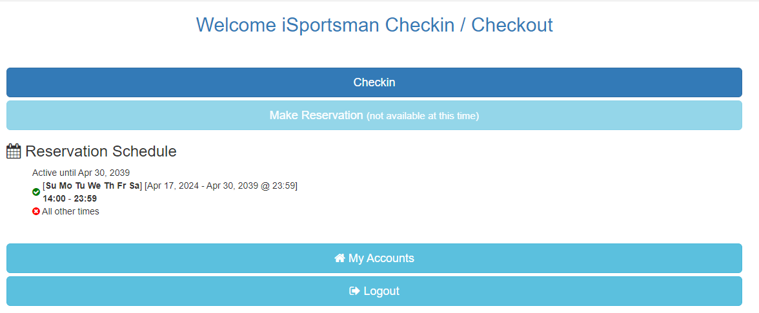
STEP 9. Making Reservations and Checking in/out
Make Reservation: Reservations can be made the day prior to a hunt (e.g., make a reservation on Friday for a hunt on Saturday) at 2:00 PM.
You can check-in to your reservation starting at 2:00 AM the next day. If you do not check-in by 8:00 AM, you will lose your spot. This will make it available to other hunters.
Check-In: The check-in button is used for same day check-in (e.g., checking in on Saturday to hunt Saturday).
same day check-in
made prior to a hunt (still need to check-in the day of)

Slide 16
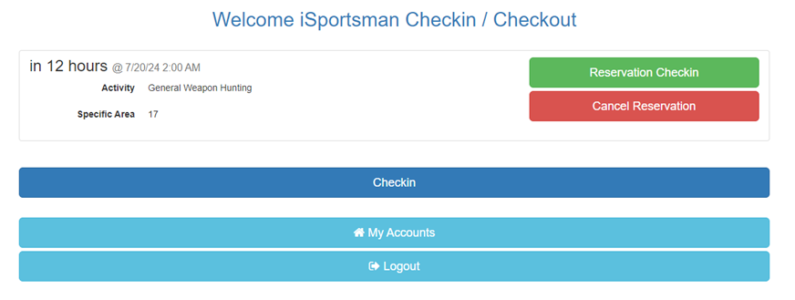
STEP 9. Making Reservations and Checking in/out
Remember to check-in to your reservation between 2:00 AM and 8:00AM.

Slide 17
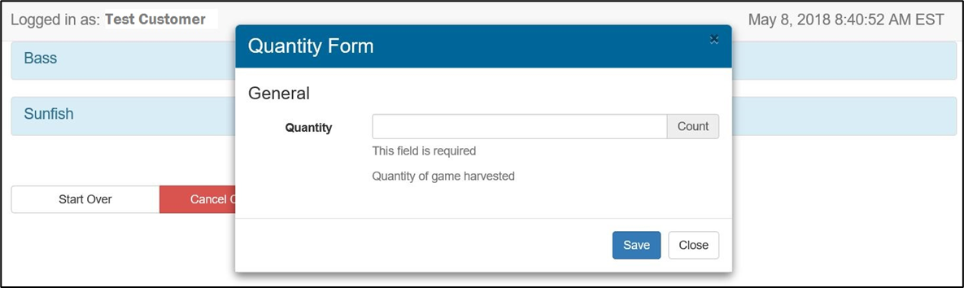
STEP 9. Making Reservations and Checking in/out
During check-out report all harvested fish and game.
All game must be reported on iSportsman even if brought to the check station.

Slide 18
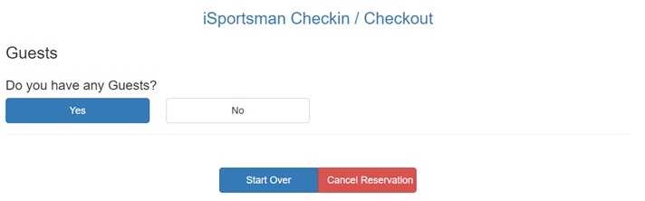
STEP 10. Adding Guests
Hunters will be prompted to add guests during the check-in/reservation process.
The Adult H&F Guest Pass is required for all adult (18+) guests. Hunt and Fish Guests are defined as persons not hunting or fishing but accompanying a registered hunter or angler.
For 18+ guests, you will need their name and FHL permit number.
For minors, you will need their name and birthdate.

Slide 19
STEP 11. Check Station
All game and fish harvested on FHL must be reported upon check-out through iSportsman. Hunters are required to bring all harvested deer and elk to the wildlife check station for data collection when open. All other harvested game may be required to be brought in when requested. Please check out the Wildlife Check Station page.
Failure to check-in your game can result in the suspension of your hunting rights at FHL.
NEW as of 2024: All deer and elk are subject to Chronic Wasting Disease (CWD) sampling.
See next slide for check station location.

Slide 20
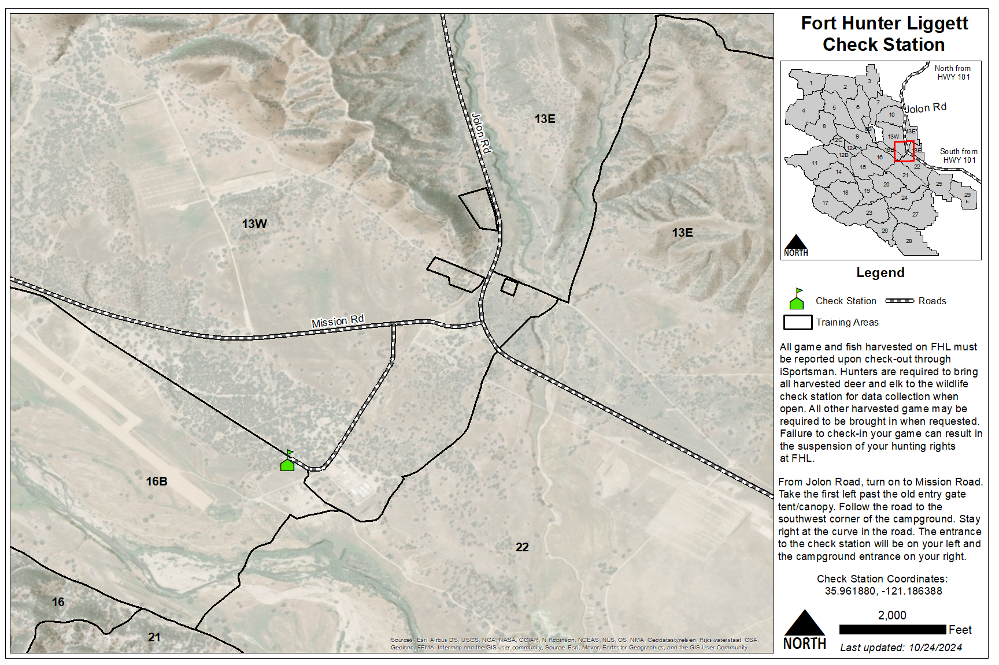
STEP 11. Check Station

Slide 21
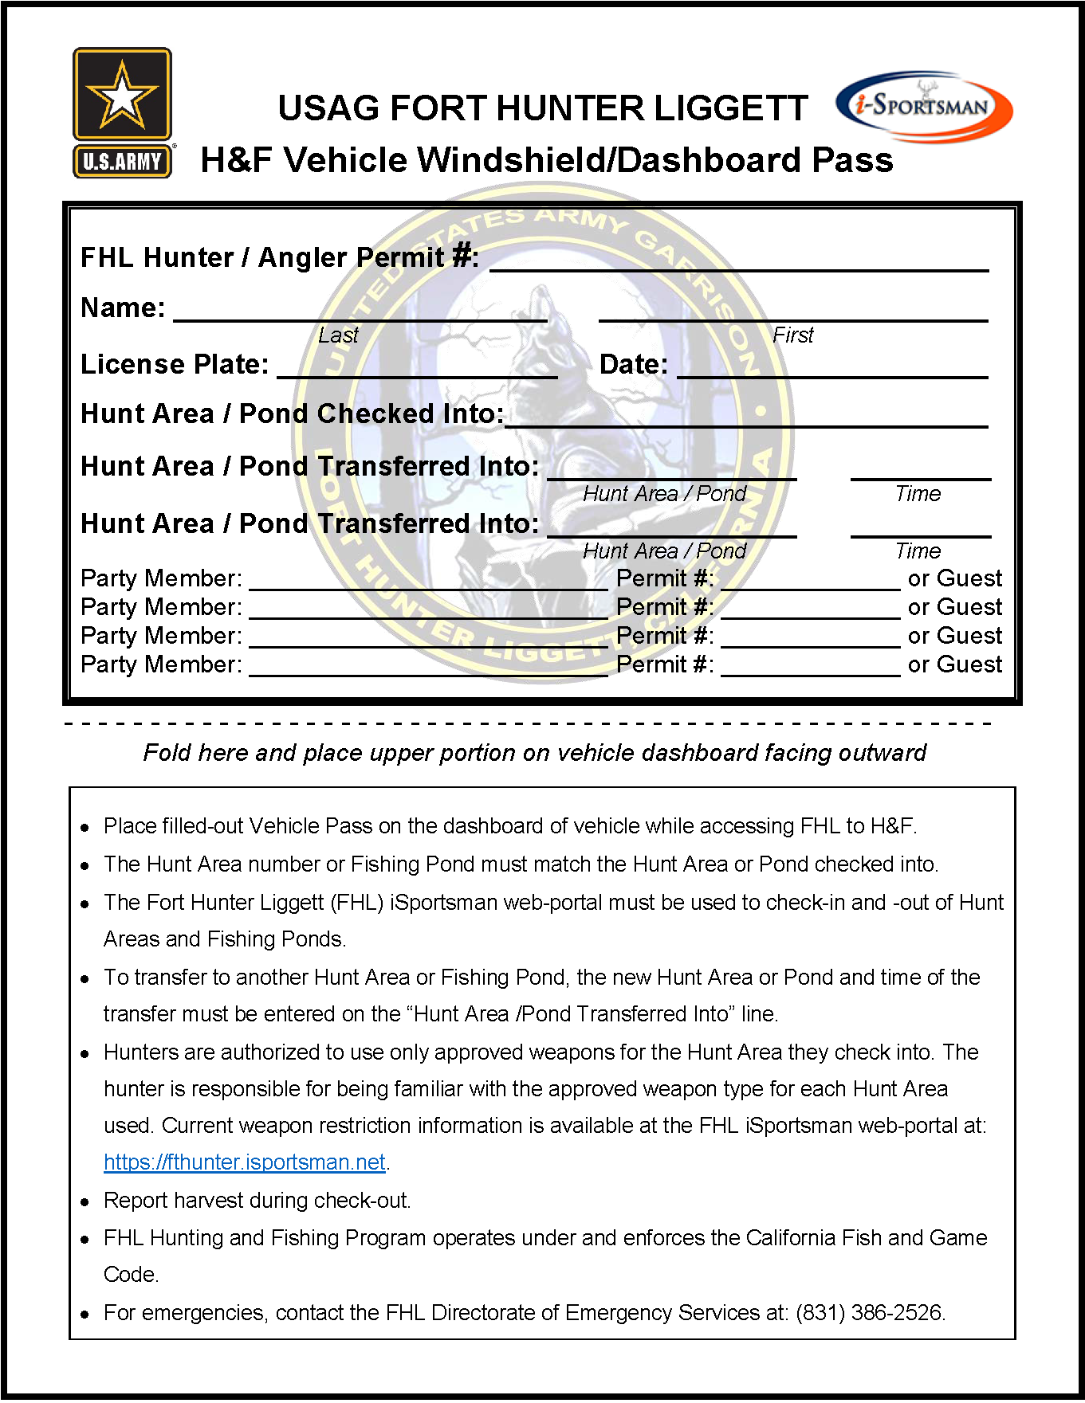

STEP 12. Going Afield
Check-in to an open area through iSportsman
Weapon Permit from the VCC (if you plan on going into the cantonment area)
CA hunting and/or fishing license, validations, stamps, and tags
FHL hunting and/or fishing permit
Vehicle Windshield/Dashboard Pass
Familiarize yourself with the FHL H&F Regulation 420-26 and CDFW regulations

Slide 22
Questions
Please contact the FHL Hunting and Fishing Program with any questions.
(831) 241-1182
usarmy.hunterliggett.id-readiness.mbx.hunt-and-fish-program@mail.mil

